Slide 1




Choice of Best Hydroxyapatite (HA) Coated Sensors to Measure Bone Maintaining Activity in Space
Stephany R. Maldonado
John A. Szivek, Department of Orthopaedic Surgery
Tempe, Arizona
April 22nd, 2023

Slide 2
Introduction
Osteoporosis is a disease that develops when bone mass and mineral density decrease, leading to a decrease in bone strength.
Osteoporosis affects over 44 million Americans; most are over the age of 50. Accurate bone loss measurements are difficult to collect.
Bones mass and healing are dependent on mechanical loading.
Inactivity or reduced gravity leads to bone density loss, consequently astronauts face 1-2% of density loss each month they spend in space.

Slide 3
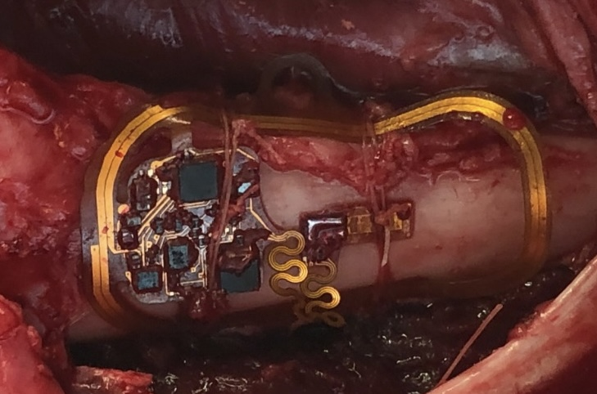
Introduction continued
The best way to directly measure bone deformation is with strain gauges.
Adhesives like cyanoacrylate degrade rapidly in vivo.
Previously used calcium particles (CPCs) bond well to bone and remain securely bonded.
The purpose of this experiment is to compare bone boning of new Hydroxyapatite (HA) particles in tissue culture to CPC particles.
Strain gauge and radio telemetry system attached
to surface of a sheep’s femur.

Slide 4
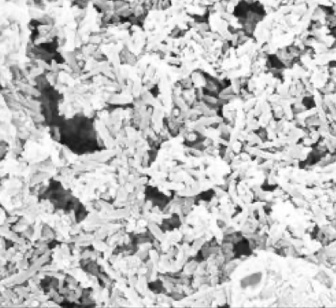
Methods
Seven types of HA particles (HA 2, 4, 5, 6, 7, and 9) were compared to CPC 6 particles.
Seven well plates were coated with each particle using epoxy.
Plates were sterilized using ethylene oxide.
Scanning Electron Micrograph of HA 5
Image from Mataxcel

Slide 5
Methods continued
Scanning electron microscopy (SEM) was used to ensure particle homogeneity
Each well was seeded with 5000 human mesenchymal stem cells (MSCs) and were maintained in 500 µL of Dulbecco’s Modified Eagle Media, which was changed 3 times a week.
Alkaline Phosphatase (ALP) activity was measured at week two and six, using an assay.
Direct Red-80 staining was used to stain for collagen.

Slide 6
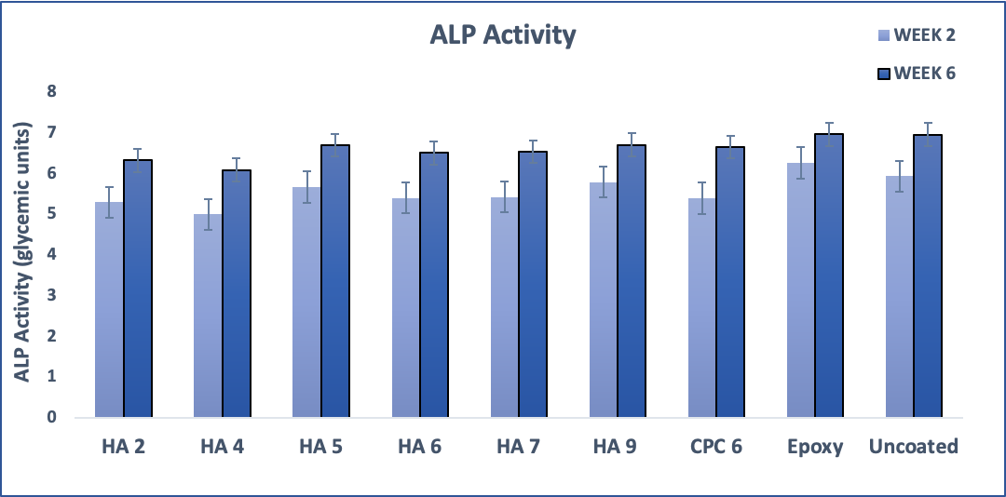
Results
SEM demonstrated that all the particles would be exposed to the cells and evenly distributed
ALP activity increased at week 6 compared to week 2
SEM of well coated with HA 7

Slide 7
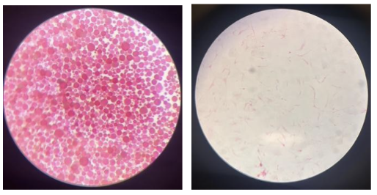
Results continued
Direct Red-80 staining indicated higher collagen in the HA coated wells compared to the uncoated wells.
Direct Red 80 staining of HA 7 (left) and uncoated well
(right) at week 2

Slide 8
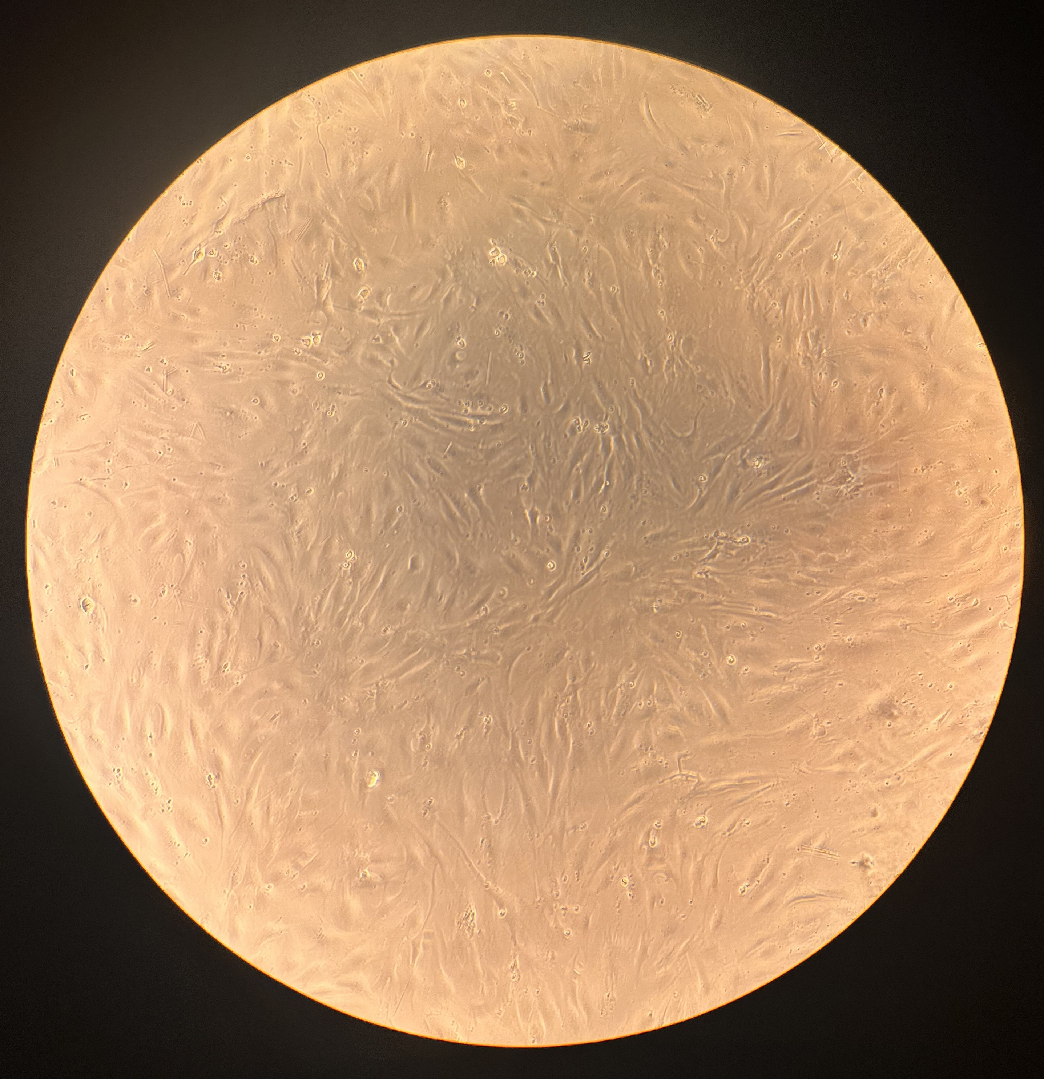
Conclusion
HA, CPC and epoxy coatings facilitated cell proliferation.
ALP activity increased from week 2 to week 6.
All particle coated wells showed collagen production.
Preliminary results indicate that HA 7 facilitates the most collagen production.
MSCs growing on an epoxy
coated well.

Slide 9
Acknowledgements
Supported in part through the Arizona NASA Space Grant Consortium, Cooperative Agreement 80NSSC20M0041.
I would like to express my gratitude to Dr. John A. Szivek for being my mentor throughout this project.
I am also deeply thankful for the help and support of Dr. David S. Margolis.
Special thanks to Gerardo Figueroa and David A. Gonzales.

Slide 10
Thank you ☺

